Slide 1
Amazon Strategic Management Analysis.
By Name.
Institutional Affliation

Slide 2
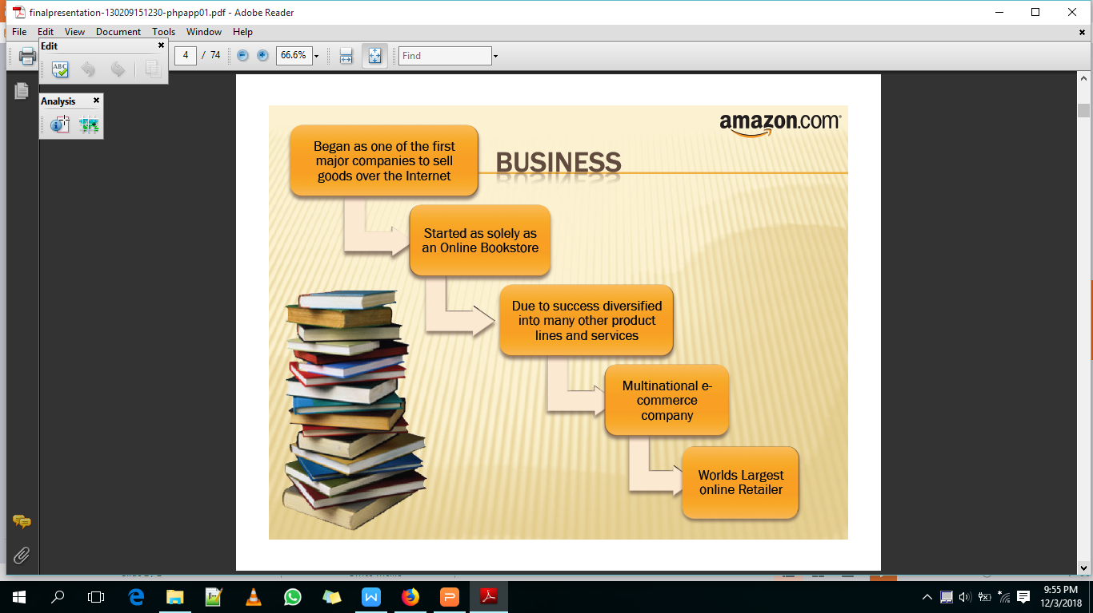
History of Amazon.com Inc

Slide 3
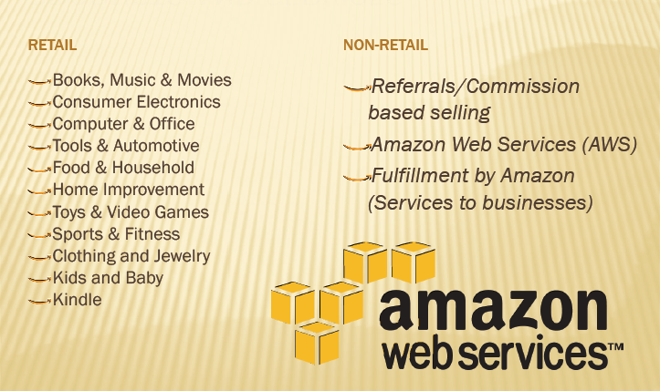
Products and Services

Slide 4
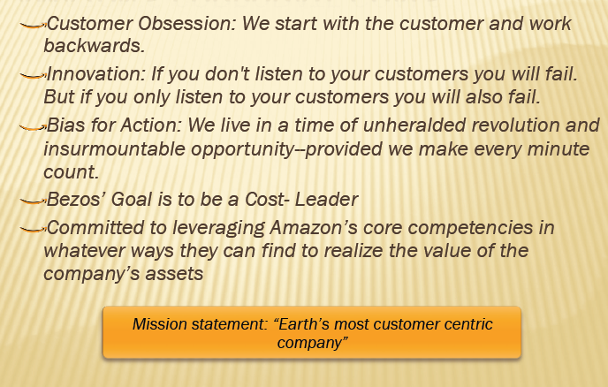
Organization Goals

Slide 5
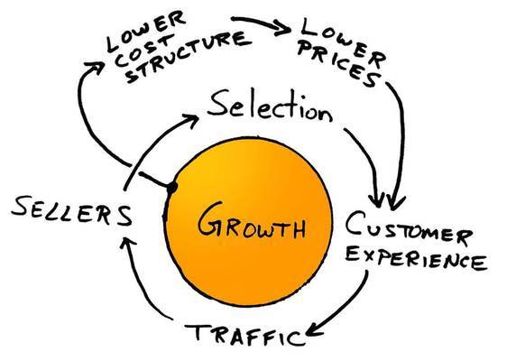
Bussiness models and strategies- Napkin-diagram
Notes:
lower prices will eventually lead to a higher number of customer visits. With more customers, there would be an increased volume of sales that will attract commission paying sellers.

Slide 6
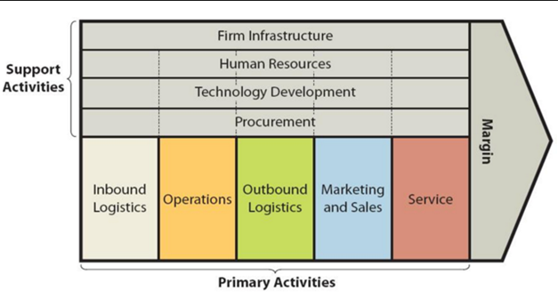
Situational Analysis
Notes:
The first opportunity is the expansion and global growth, which is primarily based on the widespread and development of e-commerce across the world, which enables it to capitalize on technological trends.
he third opportunity consists in strengthening network externalities based on the positive effect of a broader customer base, which boosts the importance of its services by increasing the market share and customer base.

Slide 7
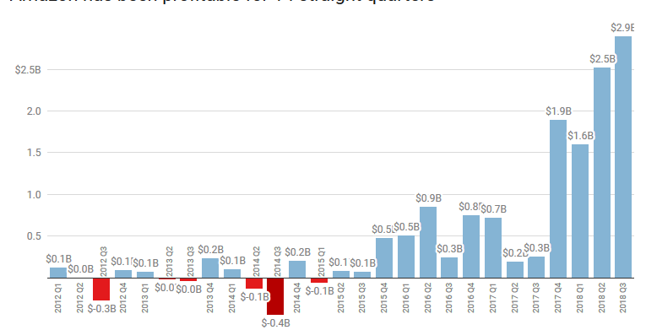
Amazon Profit Margins.
Notes:
The company has started experiencing consitsent profit margins in the recent past. Being profitable for 14 straight quarters. The company reached an all time high of $2.5 billion in the third quarter of 2018

Slide 8
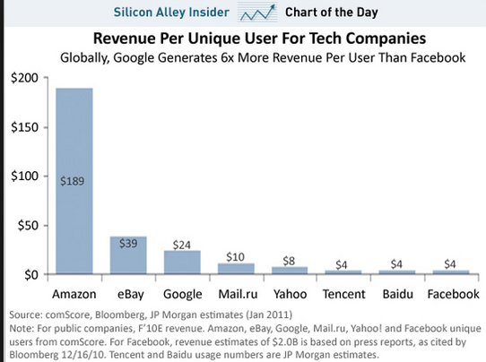
Amazon continuos growth.
Notes:
A 2017 survey indicated that Amazon dominated the world of e-commerce with a revenue of over $177 billion representing over 14.8% of the global market share. In the US alone the company’s net income was to the tune of $54.3 billion representing over 34% of the total market share. From a customer base of around 1 million users, the company now records of extraordinary support of over 182 million users.

Slide 9
Amazon Strengths
Customer centric
Unique Team/strong leadership
Wide product range.
Strong brand image.
Price leadership
Extensive customer base
Innovation
Improved technology

Slide 10
Weakness
Non-competitive price of products.
Debt financing.
Poor customer profiling
Increased Operation cost

Slide 11
Opportunities
Growing and expanding markets. (Asia pacific, Africa and the developing world)
Expansion to cater for a wider variety of products.
Improved compatibility.
Increased demand for mobile technology.
Better customer profiling

Slide 12
Threats
Intense competition from rivals such as Ebay and Alibaba
Rising manufacturing cosy
financial losses
Price wars

Slide 13
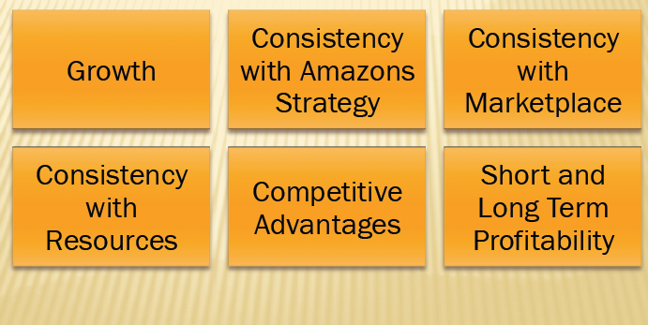
Criteria for evaluation.

Slide 14
Reccomendations
Pursue more expansion.
Discard high-cost projects that do not portay much potential. An example of a product that can be discraed is Kindle fire.
Expnsion of their cloud computing and advertisement projects which have generated much revenue in the past
There is a need to have operational excellence of the brand and the Amazon understands how they need to do their strategies and implementations.

Slide 15
Conclusion.
Amazon focuses on low-cost strategy and effective innovativeness to gain competitive advantage against its competitors. The company is focused on gaining customer satisfaction, thus creating loyalty and guaranteeing returningcustomers, along with new customers due to the exciting nature of the brand. The tools discussed in this report highlight that Amazon's dominance as brand and business in the E-Commerce sector is a testament to their superior strategies.

